Slide 1

Title: Welcome to the Store Annual Report 2025
Subtitle: Based on E-commerce Order Data Analysis
Presented By:- Manjeet Gupta

Slide 2
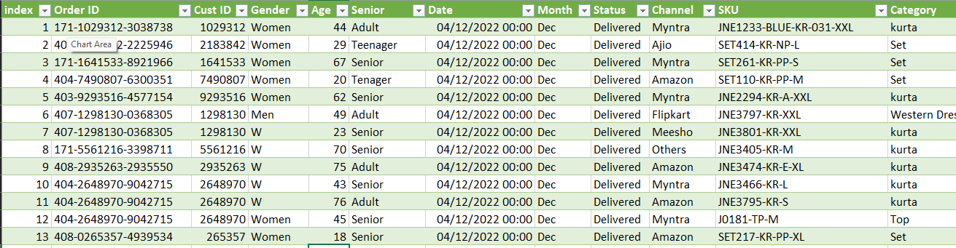
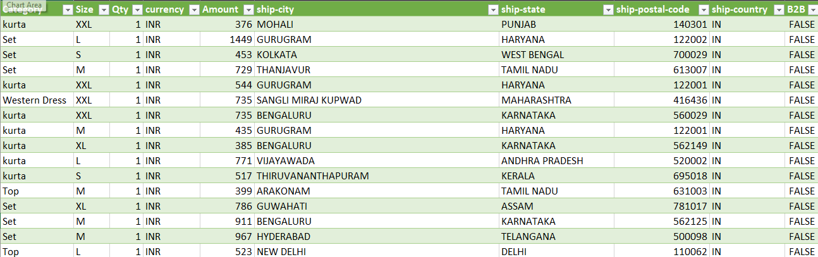
STORE DATA TABLE

Slide 3
Overview
Content:
Monthly Orders vs Sales
Customer Gender Distribution
Order Status Performance
Age vs Gender Orders
Top 10 States Sales
Channel-wise Orders
State-wise Sales Map
What to Speak:
"This presentation summarizes our performance across months, genders, channels, states, and order categories."
"Each section highlights a specific part of our business to understand where we performed strongest."

Slide 4
Summary – Store Annual Report
The Store Annual Report 2025 highlights overall business performance across sales, customer behavior, and regional insights. Sales peaked between February and May, while women contributed the majority of purchases at 64%. Order operations were highly efficient, with 92% successful deliveries and minimal returns or cancellations. Senior customers formed the largest buying group, followed by adults. Maharashtra, Karnataka, and Uttar Pradesh emerged as the top-performing states. Amazon remained the strongest sales channel, followed by Myntra and Flipkart. Overall, the report shows strong customer engagement, high delivery success, and clear trends for future strategic planning.

Slide 5
Orders vs Sales (Line + Bar Chart)
Content:
Highest sales between February–May
Gradual decline after June
December shows slight recovery
Orders and sales follow a similar pattern
What to Speak:
"This chart shows our monthly performance. We see that February to May was our strongest period with peak sales."
"From June onward, there was a slow decline, possibly due to seasonal factors."
"December shows a small recovery, indicating the impact of festivity sales."

Slide 6
Men vs Women (Pie Chart)
Content:
Women: 64%
Men: 36%
Women drive majority of purchases
What to Speak:
"Customer purchases are heavily dominated by women, contributing to 64% of total orders."
"This indicates a strong female user base and suggests opportunities to target female-centric campaigns."

Slide 7
Order Status (Pie Chart)
Content:
Delivered: 92%
Returned: 3%
Cancelled: 3%
Refunded: 2%
What to Speak:
"Order quality is excellent with 92% successful deliveries."
"Only 3% cancellations and 3% returns show operational efficiency."
"Refund percentage is minimal at 2%, reflecting customer satisfaction."

Slide 8
Age vs Gender (Bar Chart
Content:
Teenagers: 0%
Adults: 27.52%
Seniors: 41.91%
Women lead across age groups
What to Speak:
"The majority of buyers come from the senior age group at nearly 42%."
"Adults contribute 27.5%, and teenagers are almost negligible."
"This helps us understand where our main purchasing power lies."

Slide 9
Top 10 States (Horizontal Bar Chart)
Content:
Maharashtra highest
Followed by Karnataka, Uttar Pradesh, Telangana
West Bengal is lowest among the top 10
What to Speak:
"Maharashtra leads the sales chart with the highest order value."
"Karnataka and Uttar Pradesh follow strongly."
"This gives us clarity on the highest revenue-generating regions."

Slide 10
Orders by Channel (Pie Chart)
Content:
Amazon: 35.5%
Flipkart: 21.6%
Myntra: 23.4%
Others (Ajio, Nalli, Meesho): remaining share
What to Speak:
"Amazon is our strongest sales channel with 35.5% contribution."
"Flipkart and Myntra also perform well."
"Other channels like Ajio and Meesho collectively add smaller contributions but offer growth opportunities."

Slide 11
States & Amount (Geo Map
Content:
High-value states highlighted
Clear difference between lowest and highest purchase zones
What to Speak:
"This map visualizes the geographical distribution of sales."
"Northern and Western regions show strong purchasing patterns compared to some eastern states."
"This helps in planning region-specific strategies."

Slide 12
Dataset Summary:- Dataset Size: 31,048 rows × 20 columns
Columns Description (one line each):- Index, Order ID, Cust ID, Gender, Age, Senior, Date, Month, Status, SKU,
Size Qty ,Currency ,Amount ,Ship-City ,Ship-State ,Ship-Postal-Code ,Ship-Country ,B2B

Slide 13
Summary
The Store Annual Report 2025 highlights overall business performance across sales, customer behavior, and regional insights. Sales peaked between February and May, while women contributed the majority of purchases at 64%. Order operations were highly efficient, with 92% successful deliveries and minimal returns or cancellations. Senior customers formed the largest buying group, followed by adults. Maharashtra, Karnataka, and Uttar Pradesh emerged as the top-performing states. Amazon remained the strongest sales channel, followed by Myntra and Flipkart. Overall, the report shows strong customer engagement, high delivery success, and clear trends for future strategic planning.

Slide 14
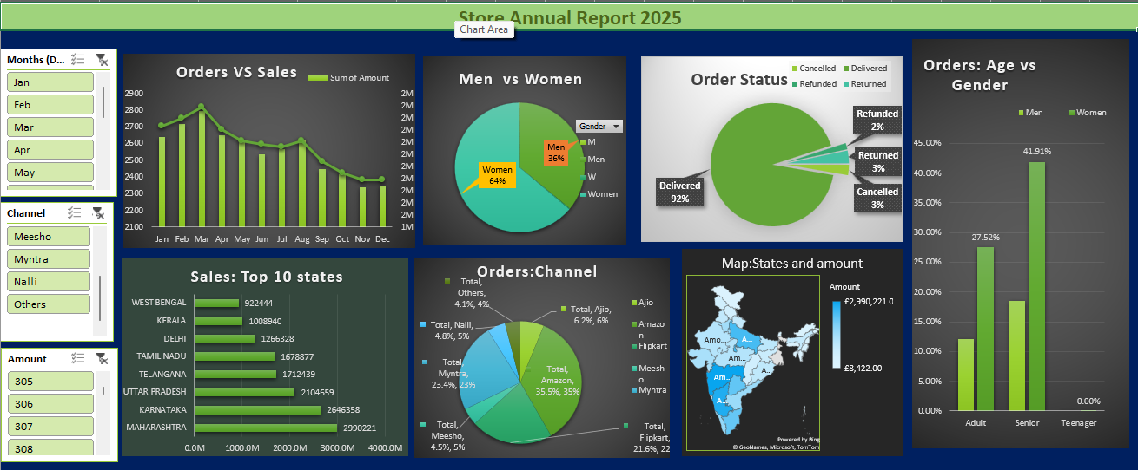
DASHBAORD

Slide 15
Formulas:-
if the order is delivered or not. Used to classify orders :-=IF(Status="Delivered", "Successful", "Not Delivered")
Categorizes customers into Teenager, Adult, or Senior based on Age.
=IF(Age<=18,"Teenager",IF(Age<=40,"Adult","Senior"))
the total sales amount:- =SUM(Amount)
Counts how many orders were placed by Female customers:-=COUNTIF(Gender,"Female")

Slide 16
Key Insights / Findings
The highest sales category is Electronics and Apparel.
Most purchases are made by the age group 25–40.
Top sales channel is online platforms.
Female customers contribute more orders..
Sales peak in November and December due to festivals.
Metro cities like Delhi and Mumbai show the highest shipments.

Slide 17
Advantages and Disadvantages
Advantages:
Handles 31K+ rows efficiently with pivot tables
Easy filtering with slicers for better analysis
Visual charts help in understanding sales trends
Quick to build and update without coding
Disadvantages:
Large dataset may slow down Excel performance
Limited automation compared to BI tools
Difficult to manage real-time or live data
File sharing and collaboration less efficient

Slide 18
Conclusion
Overall, the database provides comprehensive order-related information, while the dashboard converts that raw dataset into clear and actionable insights. It enables decision-makers to quickly identify sales patterns, customer preferences, regional demand, and business challenges, thereby making the project highly effective and valuable.
Content:
Strong performance in early months
Female customers dominate
Delivery success rate excellent
Amazon and Flipkart are the strongest channels
Maharashtra leads in state-wise sales
What to Speak:
"Overall, 2025 has been a productive year with strong customer engagement and high delivery success."
"Female customers are our biggest contributors."
"Sales channels and states give us clear direction for future focus areas."

Slide 19
THANK YOU

